Slide 1
Topic – Free Consent and Void Agreement

Slide 2
Presented by: Group No 13

Slide 3
Content
Definition of Contract
What is Consent
What is free consent
Coercion
Undue Influence
Fraud
Misrepresentation
Mistake
Case Study
Effect of Free Consent
Case Study
Void agreement
Example of void agreement
Legal Consequences of void agreement
Free consent is what’s important
Features of free consent
Difference between coercion and undue influence
Conclusion

Slide 4




📘 Definition of Contract (
A contract is a legally enforceable agreement 📜 made between two or more parties 🤝 that creates rights and obligations recognized by law ⚖️.
According to Section 2(h) of the Indian Contract Act, 1872,
Not all agreements are contracts. Only those that can be enforced by law are considered valid contracts. For example, if A promises to sell his car 🚗 to B for ₹3,00,000 and B agrees to buy it, this is a contract. But if A promises to take B for dinner 🍽️, that is just a social agreement, not a contract, because it cannot be legally enforced.
⚙️ Essential Elements of a Valid Contract:
🤝 Offer and Acceptance – There must be a lawful offer and its lawful acceptance.
💡 Intention to Create Legal Relations – Both parties must intend to be legally bound.
💰 Lawful Consideration – Each party must give and receive something of value.
👥 Capacity of Parties – Parties must be competent (of sound mind and legal age).
❤️ Free Consent – Consent must be free and not obtained by force of other party.

Slide 5
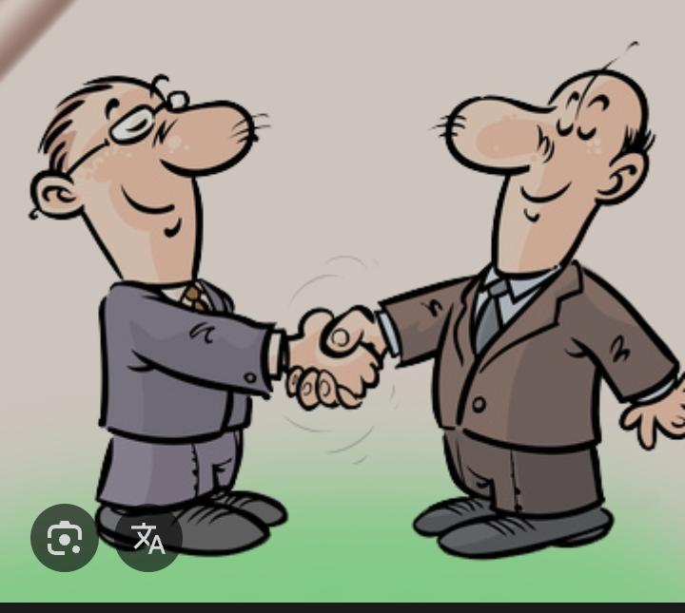
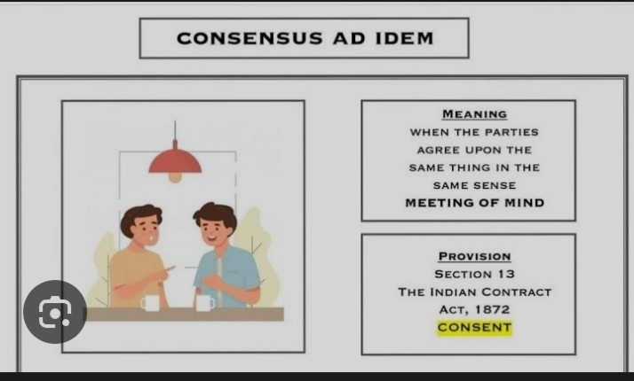
What is Consent ?
According to section 13 of the Indian contract act, Consent is when someone gives Clear and voluntary Permission For something to happen. It means they fully Understand What they’re doing It by choice-Not because They were Pressured, forced, Tricked, or scared into it. True consent must be freely given, informed, and taken back at any time. For Example: If a doctor wants to operate on a patient, then it is necessary to take written consent from the patient. If the patient agrees to the operation without any pressure, then it is legally considered as consent.

Slide 6

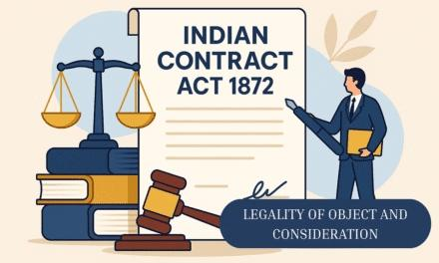
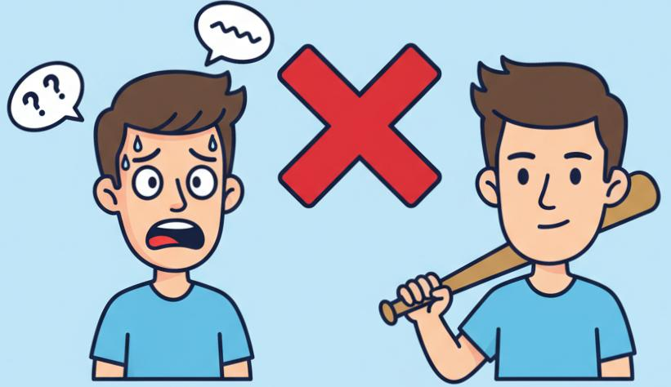
What is free consent....? With example
1. Free Consent means agreement given without any pressure. 2. It is the willingness of a person to enter a contract. 3. Consent must be honest and voluntary. 4. No one should be forced or threatened. 5. Free consent shows mutual understanding between parties.
6. Consent is free if not caused by coercion. 7. Consent is free if not caused by undue influence. 8. Consent is free if not caused by fraud. 9. Consent is free if not caused by misrepresentation. 10. Consent is free if not caused by mistake. 11. Free consent ensures validity of any contract. 12. It protects parties from legal disputes.
13. Example of coercion: Ram forced Shyam to
sell land. 14. This type of consent is not free. 15. Example of willing consent: Shyam
sells land by choice ← Free Consent.

Slide 7
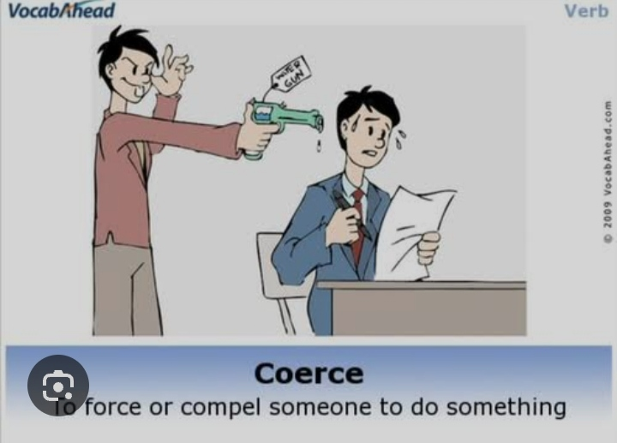
Coercion
Definition
Coercion means committing or threatening to commit any act forbbidden by law, or unlawfully detaining or threatening to detain any property, with the intention of causing a person to enter into an agreement.
Example:
1. A threatens to harm B family if B does not sell his house. B signs under coercion
The contract is voidable.
2. A points to gun at B and says “sign this contract”.
B sign it out of fear – this is coercion.

Slide 8
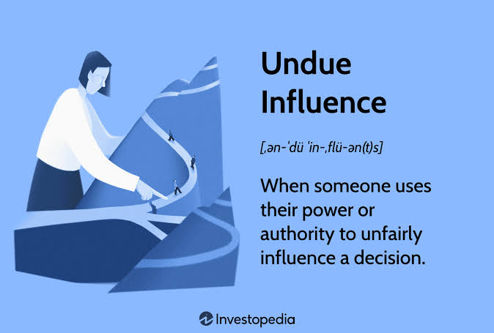

Slide 9
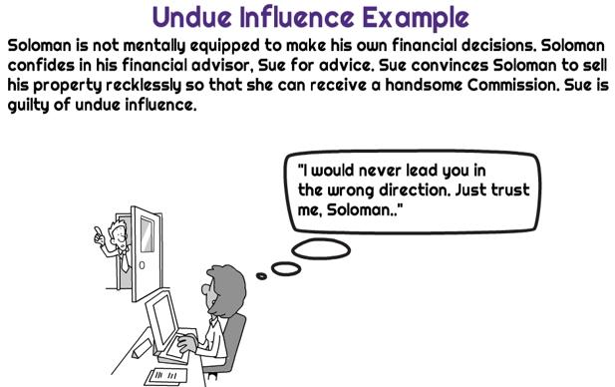

Slide 10



FRAUD
ACCORDING TO SEC-17 OF INDIAN CONTRACT ACT FRAUD Is a situation when a party involved in a contract ‘Intentionally’ tries to deceive or cheat the other party Or violates the essentials of a valid contract & it leads to VOIDABLE CONTRACT
The following are considered as fraud
giving false statements
Intent to deceive other party
Promises without intentions to perform it
hiding actual fact
Performing Any act that is ommited by law itself or declares to be fraudlent

Slide 11
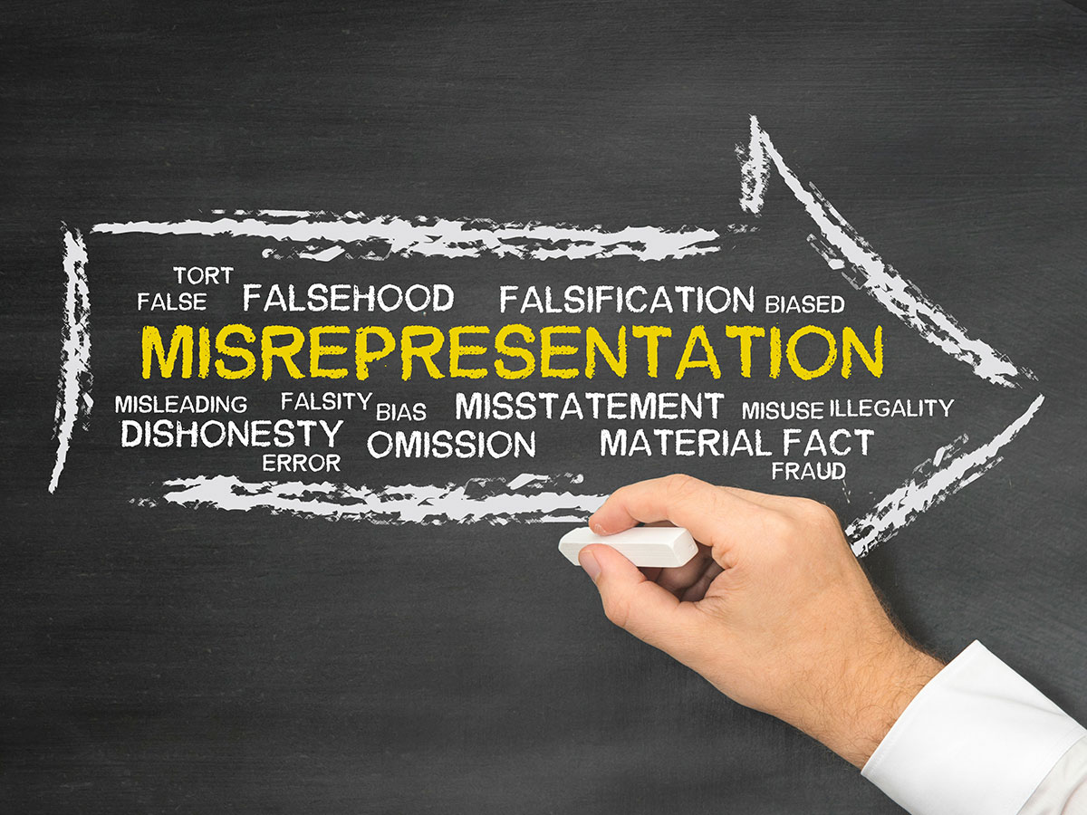
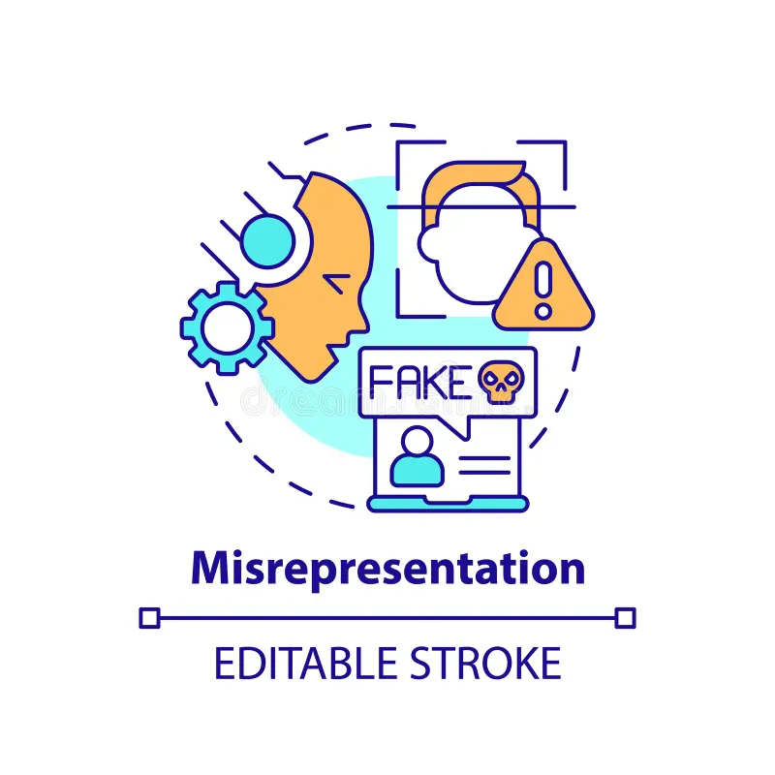
Misrepresentation
Meaning of Misrepresentation: Misrepresentation means giving false information or a wrong statement of fact by one person to another to make them enter into a contract.
If consent is obtained by misrepresentation, the contract becomes voidable at the option of the party whose consent was obtained wrongly.
Example 1:A seller tells a buyer that a car is new, but in reality, it is second-hand.→ This is misrepresentation because the buyer was misled by a false statement.
Example 2:A person says his company has government approval when it doesn’t.→ This is also misrepresentation.

Slide 12
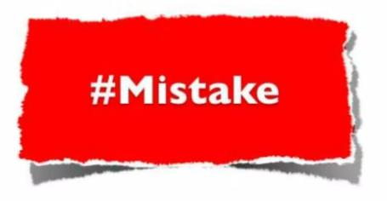
Mistake
Business law

Slide 13
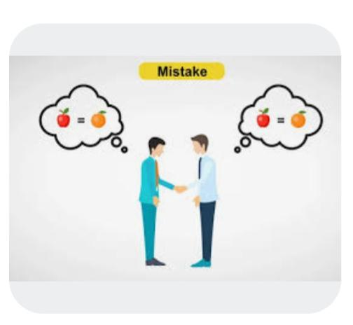
Mistake
Mistake is basically Misconception of something. Mistake may be defined as an erroneous belief concerning something. For Eg.: Mr. Raju mentiones matter ‘A’ but Mr. Shaju mistakes it as matter ‘B’

Slide 14
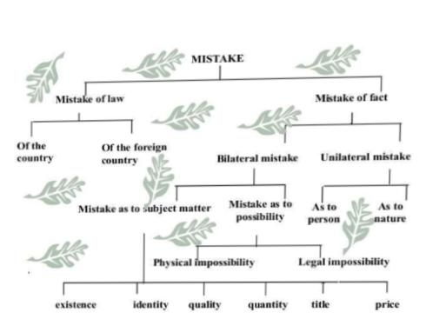
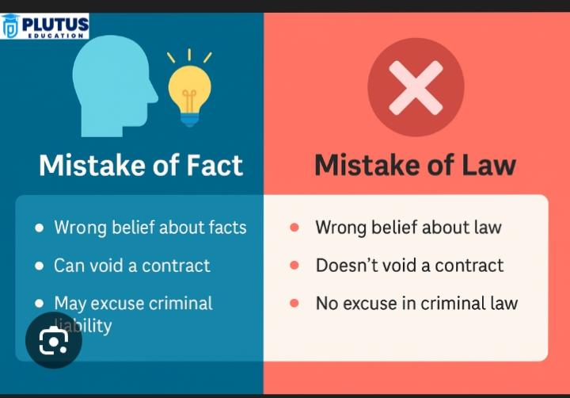
Two kinds of Mistakes

Slide 15

Mistake of law
Of the country If the mistake is regarding Indian laws, the rule is that the ignorance of the law is not a good enough excuse. This means either party cannot simply claim it was unaware of the law. Of a foreign nation Ignorance of a foreign law is not given a similar treatment. Ignorance of the foreign law is given some leeway, the parties are not expected to know foreign legal provisions and their meaning. So a mistake of foreign law is in fact treated as a mistake of fact under the Indian Contract Act.

Slide 16

Ranganyakamma vs Alwar Setti (1889)
Facts:
Ranganyakamma, a widow, was forced by her relatives to adopt a boy immediately after her husband’s death. They told that the funeral rites of her husband’s death. They told her that the funeral rites of her husband would not be performed unless she adopted the boy.
Judgement:
The court held that her consent was not free. It was obtained through coercion and undue influence.
Principle:
For a valid contract, free consent is essential under section 14 of the Indian Contract Act 1872
Conclusion
Any agreement made under coercion or undue influence is voidable at the option of the aggrieved party

Slide 17

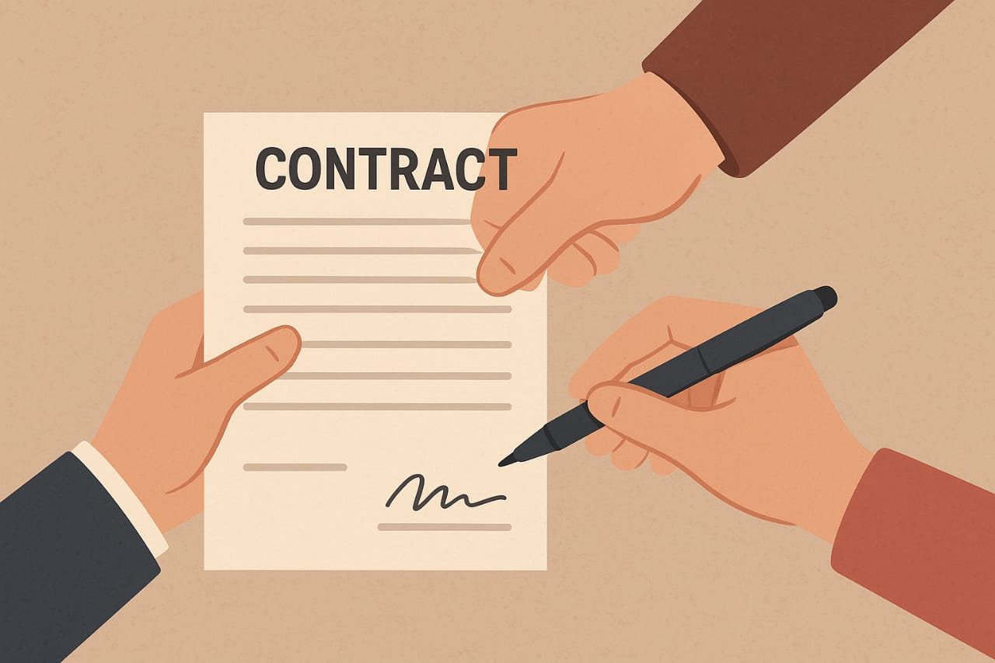

Effect of Absence of Free Consent
Types of Defect Effect on contract
Coercion. Voidable at option of aggrieved party.
Undue Influence. Voidable
Fraud Voidable+Damages
Misrepresentation. Voidable
Mistake(Bilateral). Void (No contract formed)
Mistake(Unilateral). Usually valid(exception only)
Real Life Example
A person is force to sign a property deed under threat
Consent is not free- Contract Voidable
The person can cancel the contract in the court

Slide 18
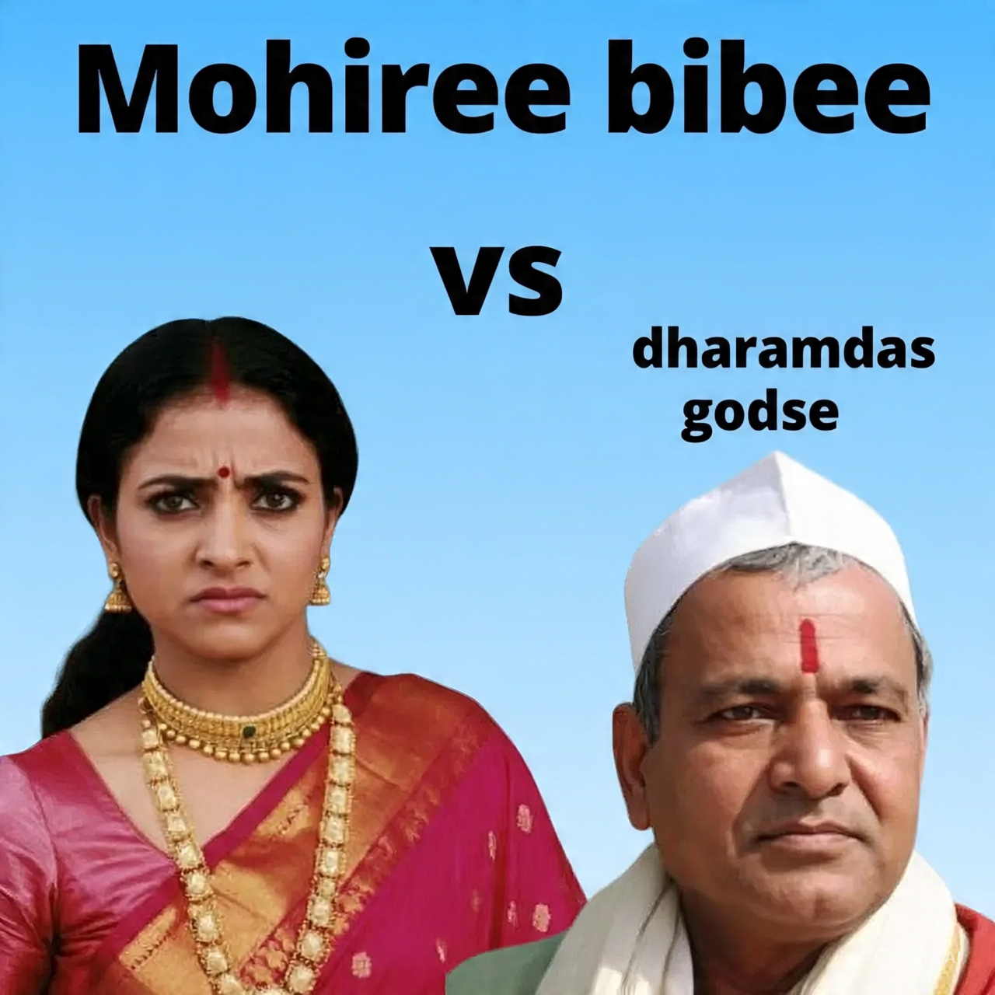
Mohiri Bibee vs Dharmodas Godse (1903)
Facts of the case
Dharmodas Ghose, a minor, mortgaged his property to Bramo Dutt(through attorney Mohiri Bibee) for Rs 20000
At the time of the agreement, the lender’s agent knew that Dharmodas was a minor
Later, Dharmodas refused to repay and argued that the mortgage was void because he was a minor.
Judgement (Privy Council):
A minor’s contract is absolutely void ab initio (from the beginning)
Section 11 of the Indian Contract Act clearly states:
“A person who is not of the age of the majority is not competent to contract”.
Therefore, the mortgage deed was void and not enforceable against the minor.
Conclusion
The case established the fundamental rule that a contract with minor is void ab initio.

Slide 19
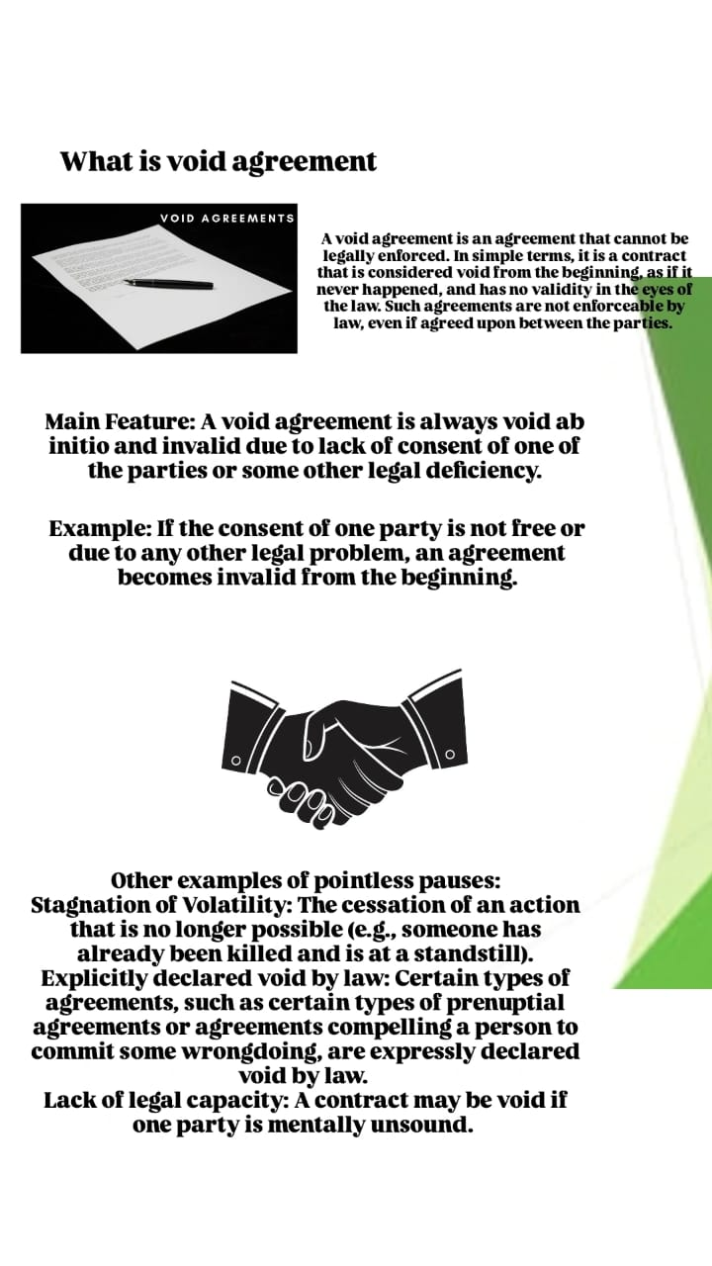

Slide 20
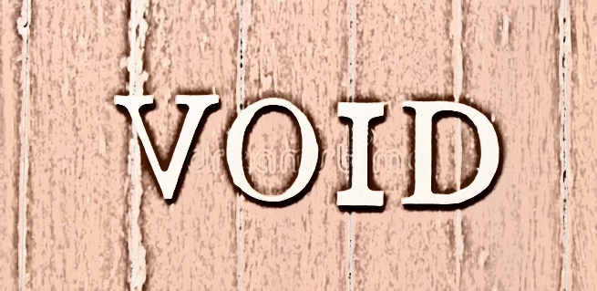
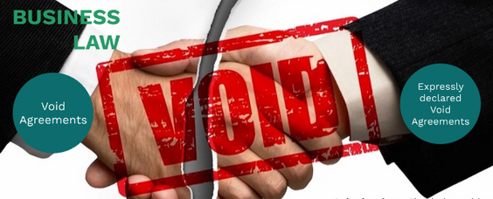
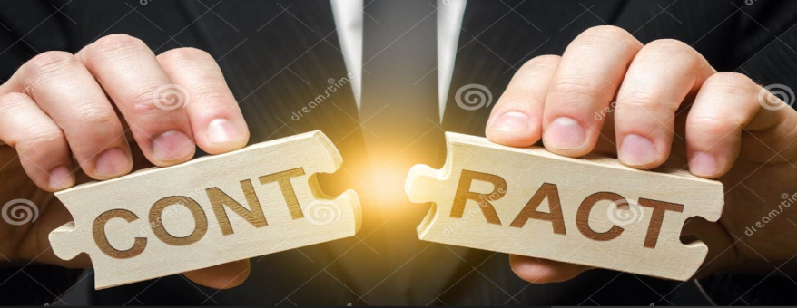
Void Agreement section (G) Indian contract act 1872
VOID AGREEMENT : A void agreement is a contract that is not legally binding from its creation and is not enforceable by law.
Characterstics of Void Agreement :
Legally non-existent : A void agreement is considered as if it never existed from the start.
Not enforceable : Because it is not legally binding, a court will not enforce its terms.
Examples for an agreement to be void :
Illegal or unlawful purpose: The agreement's object or consideration is illegal, immoral, or against public policy.
Wagering agreements: Agreements based on wagers or bets are void by law.
Uncertainty: The terms are too vague and imprecise to be enforceable.
^^^^^^The above are the examples of an agreement being void ^^^^^

Slide 21
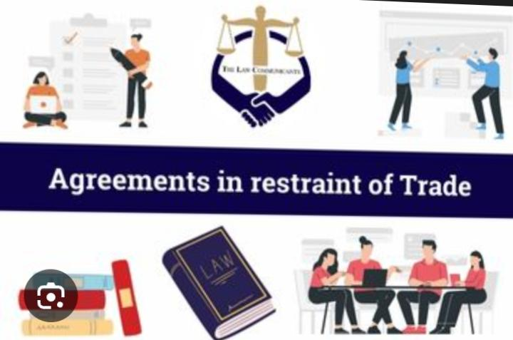
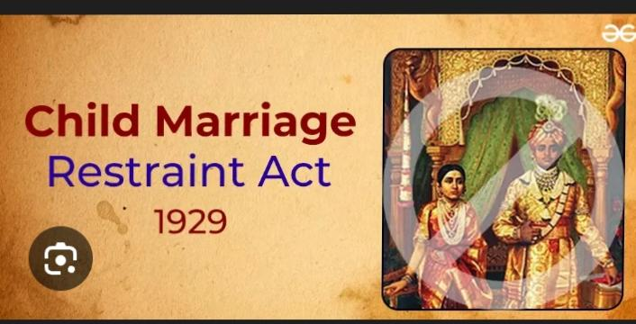
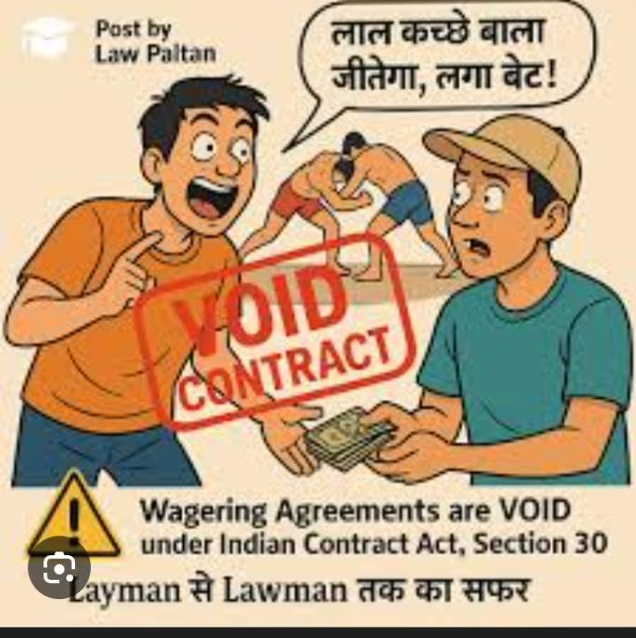
Example for void agreement
An agreement which is not enforceable by law is called a void agreement.
Example:
Stop for the impossible: A promise by one person to another that he will pay a certain sum of money if he can create gold out of thin air. This is a futile stand because it is impossible create from thin air.
Every agreement to do an impossible act is in itself void.” For example, A makes an agreement with B to extract a treasure by magic. This agreement is void because of its impossibility.
Restraint of marriage or trade:
A contract that prevents a person from practicing a lawful trade or business is void. For example, an employer cannot make an employee sign an agreement that forbids them from joining an employee union.

Slide 22
Legal consequences of void agreement
Consequences for parties
No legal obligation : both parties are free from any obligations under the agreement.
No legal remedy: neither party can take the other to court to enforce the agreement or seek damages for its breach.
Treated as non-existent: The law considers the agreement to have never existed, so it has no legal standing or effect.
Examples
Agreements with minors
Agreements for illegal acts
Agreement with no legal capacity

Slide 23

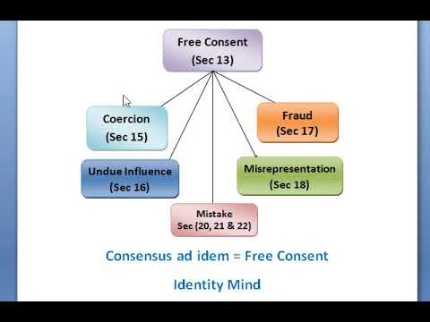
Free consent is what’s important: Free consent is what Free consent is important because it ensures and agreements are fair, just, and entered into by parties who have voluntarily agreed without coercion, fraud, undue influence, or mistake. It protects individual autonomy and voluntariness, making agreements genuinely reflect the parties’ intentions, which is crucial for their validity and enforceability in the eyes of the law
Why Free Consent is Important
Ensures Fairness and Justice: Free consent means that agreements are not a result of force or deceit, ensuring that contracts are both fair and just for all involved
Protects Individual Autonomy: It safeguards the fundamental right of individuals to make their own choices and be bound only by agreements they have genuinely and willingly made.
Builds Trust: When parties know that consent was given freely, it fosters mutual trust and cooperation, which are essential for smooth transactions and relationships.
Guarantees Validity: A contract or agreement made without free consent may be considered void or voidable, meaning it may not be legally binding or enforceable, highlighting the importance of free consent for a valid agreement.
Promotes Peace and Smooth Functioning: By preventing disputes that can arise from forced or fraudulent agreements, free consent contributes to a more peaceful and cooperative environment.
Factors That Undermine Free Consent
If consent is obtained by any of these means, it is not free consent:
Coercion (Duress): Consent obtained through threats of illegal acts or unlawful force. Undue Influence: Consent given because one party used a position of power or authority to dominate the other’s will. Fraud: Intentional deception by misrepresenting facts to trick someone into an agreement. Misrepresentation: A false statement that is not known to be false by the person making it, but which still leads the other party to enter the agreement. Mistake: A misunderstanding or incorrect belief about the facts of the agreement.

Slide 24
Characteristics of free consent
That is voluntary best of informed knowledge is tation fic and clear and and the abilities of the party giving to give depends on autonomy any kind of pressure of fraud use of face is not free to consent does not allow such a contact of exist and can declare void Main feature of free consent: 1. Voluntary. Consent is given by the person owe well without any pressure thereat or endue influence. 2. Informed. If the person giving contact has full knowledge of that matter organization including its possible effect. 3. Specific Consent related to specific and train station having clearly defined boundaries and parameters. 4. Contact. Must have the mental Capacity to understand What does understand the nature of impact. Factors restructure fee contact: If contact is a affected by any of the following elements them its not considered independent. 1.Coercion 2.Under influence 3.Fraud 4.Misrepresentation
5.Mistake

Slide 25
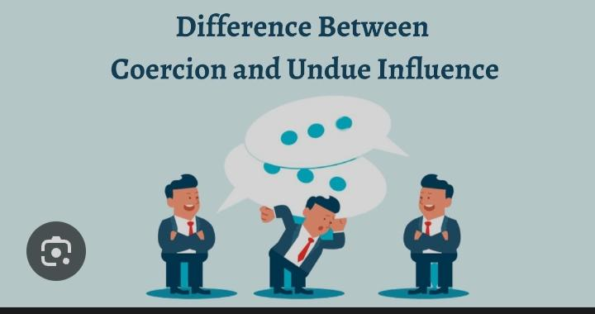
Difference between coercion and undue influence
Feature Coercion Undue Influence
Method
Direct threats, intimidation, or physical force
Psychological manipulation, persuasion, and emotional pressure
Force of pressure
Overt and explicit
Subtle and implied
Can occur between strangers or between parties with no pre-existing relationship
Typically arises from a pre-existing relationship where one party has power or trust over the other (e.g., a doctor-patient, guardian-ward, or manager-employee)
Relationship
Effect on victim
Instils fear and removes free will; the victim has no choice but to comply
Manipulates a person’s judgment by exploiting their vulnerability or dependency; they may not realize they are being influenced at the time
Example
Threatening physical harm unless someone agrees to a contract
A caregiver subtly pressuring a vulnerable elderly person to change their will in the caregiver’s favour

Slide 26
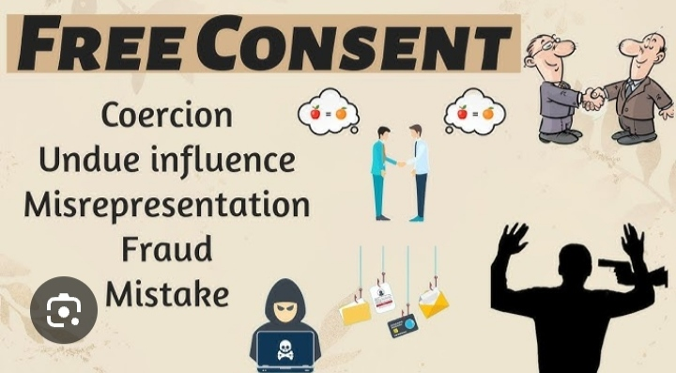
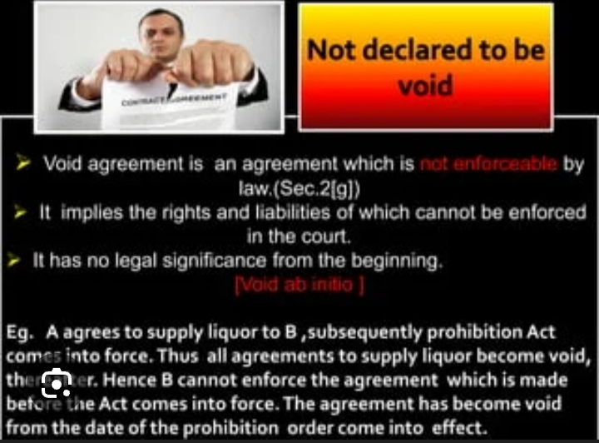
Conclusion
For any agreement to become the valid contract, the consent of all parties must be free and genuine.
If someone is forced, cheated or misled into signing a contract, it is not free consent.
Such contracts are voidable, meaning the affected person can choose to cancel it.
Some agreements are void from the beginning – like agreements with minors for illegal things. These have no legal values.
To avoid problems all parties should:
Agree willing
Understanding what they are signing
Not use pressure, threats, or lies
Simple message:
A contract is only strong when both sides agree free and fairly.

Slide 27
Presented by
Satyakam
Shahina Begam
Sheetal Nishad
Shishupal Rajak
Sheetal Dhruw
Shrey Shukla
Shrishti Baksh
Shrishti Tiwari
Shuzan Ansari
Shweta Sahu
Shiddhika Sharma
Sita
Sneha Chauhan
Sneha Ghitode
Sneha Dewangan
Someshwar Sahu
Somnath Dhruw
Siddharth Yadu

Slide 28


